Slide 1
From Decision Trees to LLaMA: Evaluating Model Performance in News Political Bias Detection
Group 10
Benjamin Lee Jun Cheng A0286163Y
Lai Foong Ming A0268245X

Slide 2
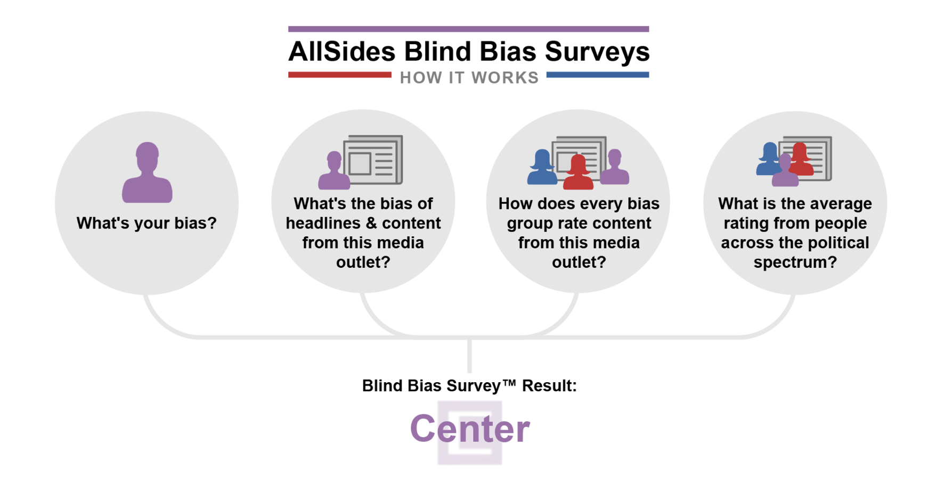
Project Motivation
Problem statement:
Human-based news rating systems are not scalable
Breaking news evaluated too late to be useful
Push notifications and RSS feeds outpace manual review
Rating sites have limited coverage of sources
Our approach:
Develop ML-based political bias classifier
Goal:
Enable instant, on-demand bias assessment to enhance media literary

Slide 3
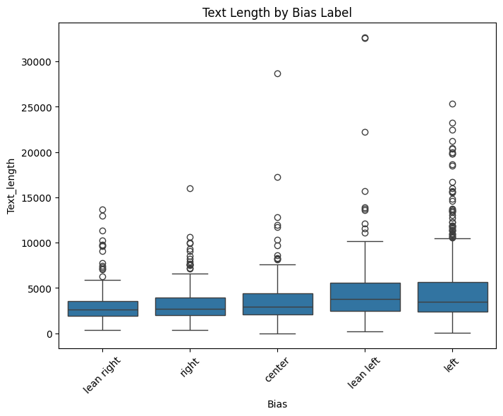
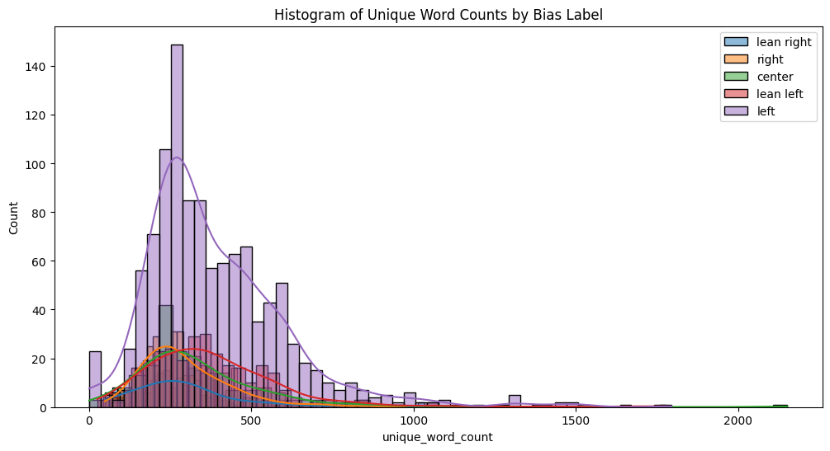
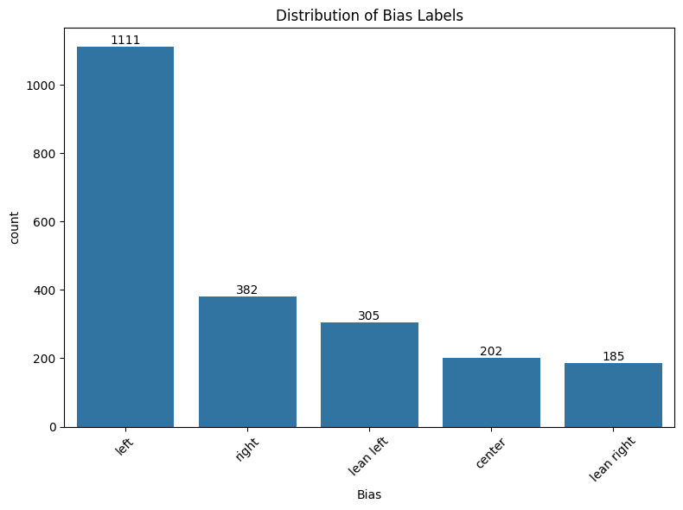
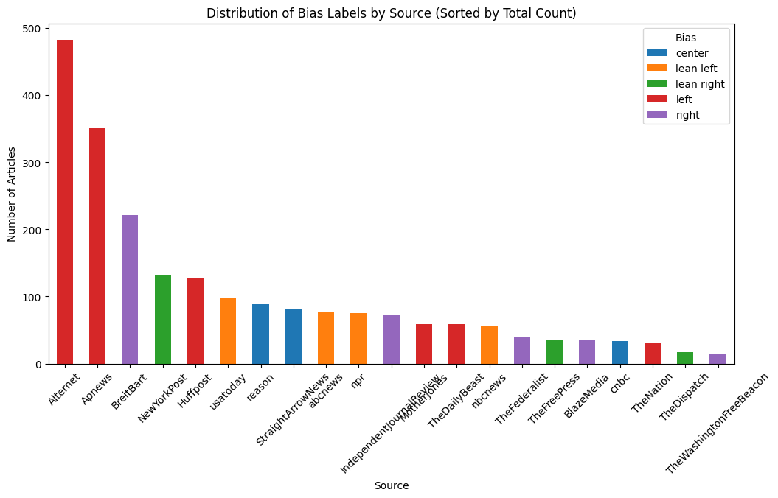
EDA
Dataset:
From Kaggle
n= 2185
5 target labels for bias:
Right, Lean Right, Centre, Lean Left, Left
News articles from 21 unique sites
Heavily imbalance towards left
Source == Bias
Analysis of text length and unique vocabulary shows that both are unlikely to be a good indicator with similar medians and IQR, as it will fail to discriminate strongly between adjacent classes

Slide 4
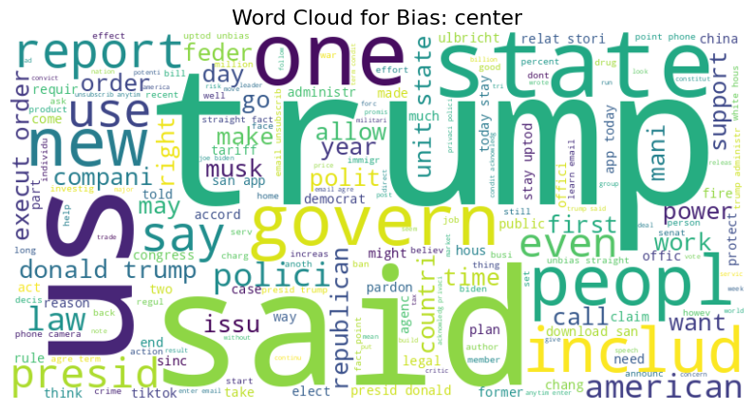
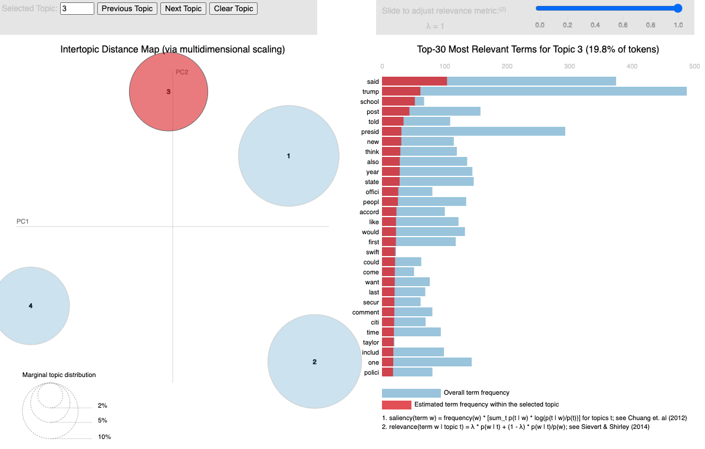
EDA
Word clouds and LDA charts for every label shows that all bias address Trump as the top content
Hence again we do not expect vocabulary to be a strong indicator
Preprocessing:
Drop Source due to being a 1:1 predictor of bias
Remove source names from article text to remove bias indicator
For TD-IDF in decision tree and FFNN, apply stemming, remove numbers and punctuation
For LSTM, BERT and Llama, use full words (retain numbers and punctuation)
Split into test and train

Slide 5
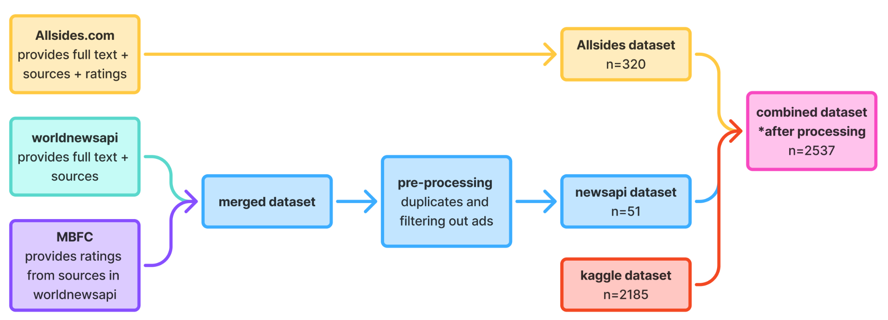
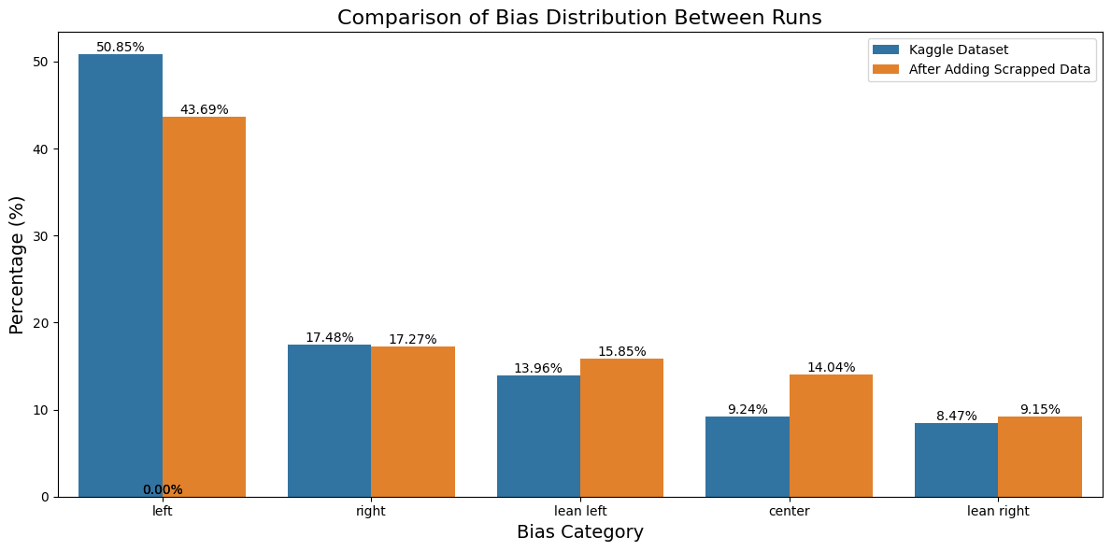
Scrapper
To deal with imbalance:
Develop a scrapper in parallel to augment data for classes with lower representations
Data needed: full text, source and bias label
Built with selenium
For allsides, we wrote a script to scrape news from the allsides.com website, focusing on general news each day, sampling roughly equal from a broader category (left, center, and right) to balance our dataset
For news api, only worldnewsapi gave the required data though it was limited and required augmentation

Slide 6
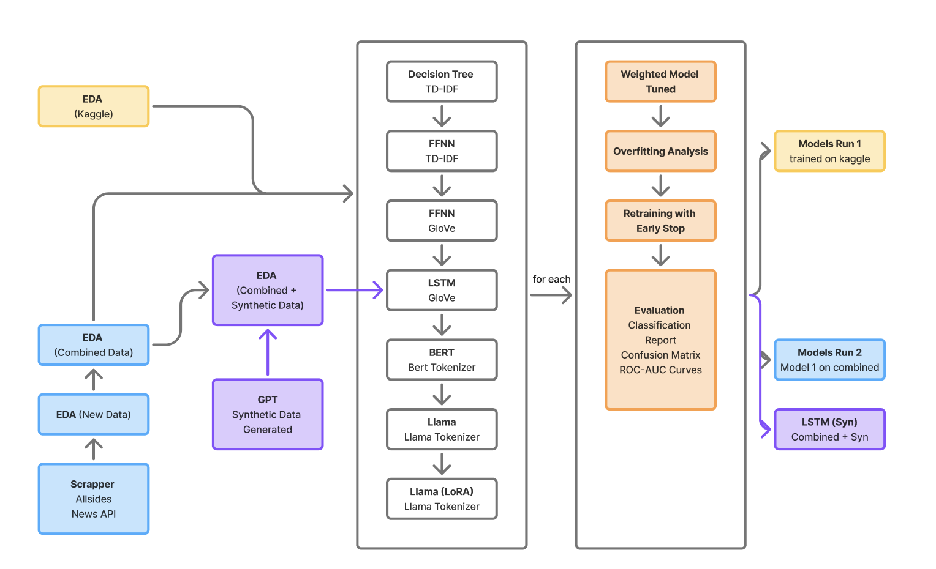
Project Flow

Slide 7
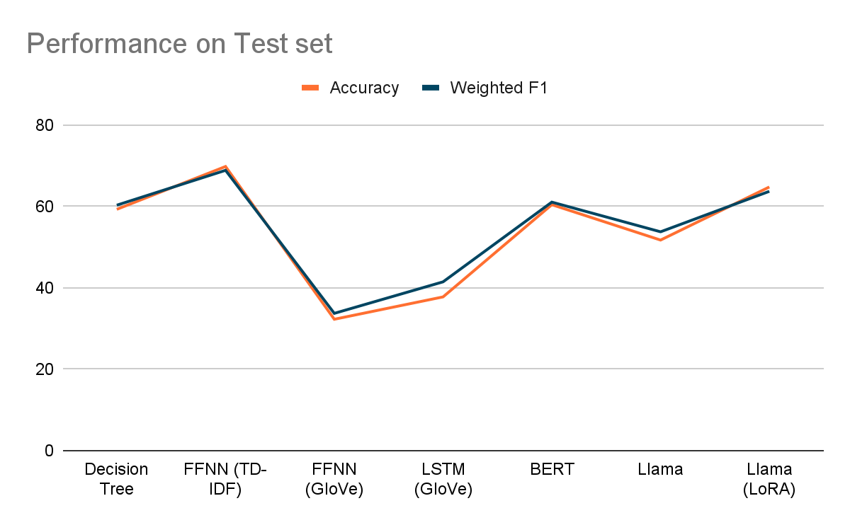
Model 1 - Headline Metrics Performance
BEN
Decision Tree’s performance placed a benchmark of at least 60% for all subsequent models
FFNN (TD-IDF) has the highest performance overall, suggesting that traditional methods with bag of words representations retain strong baseline especially when paired with dense architecture on relatively shallow tasks
FFNN (GloVe) performed worst as expected due to purposeful mismatch in design
LSTM’s significant underperformance is surprising. We explore this further.
BERT performed well out of the box and performance suggests that optimizing the model for the task might be worth testing.
TinyLlama performed worse than BERT despite the higher complexity, but the loss metric signals fine tuning is needed
TinyLlama (LoRA) performed well out of the box, but required significant time and memory to train

Slide 8
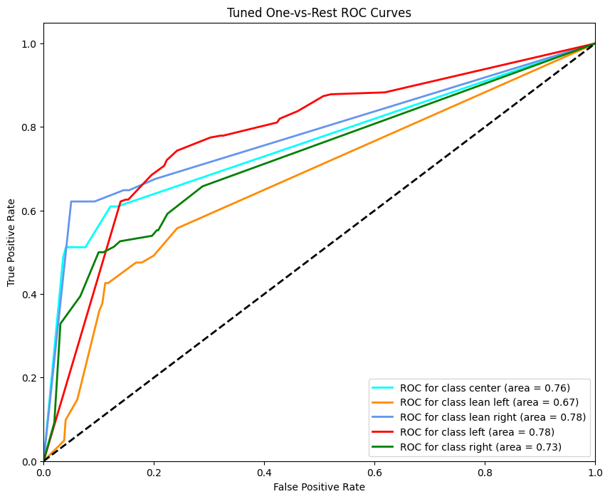
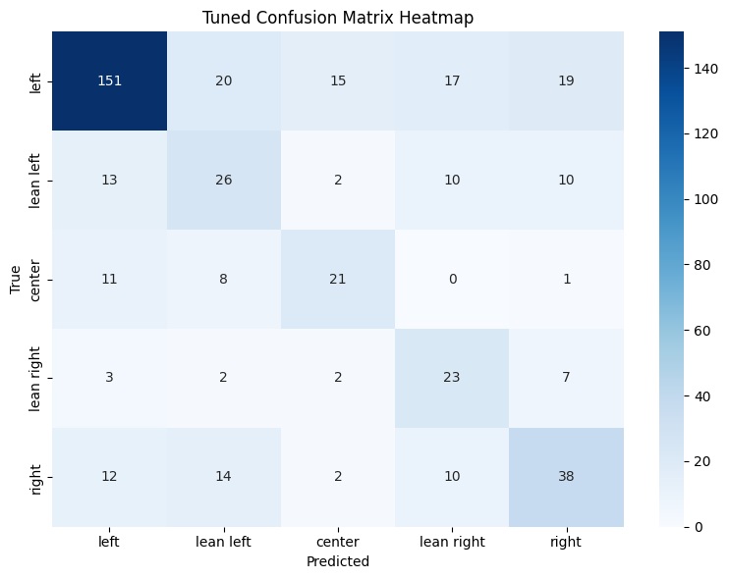
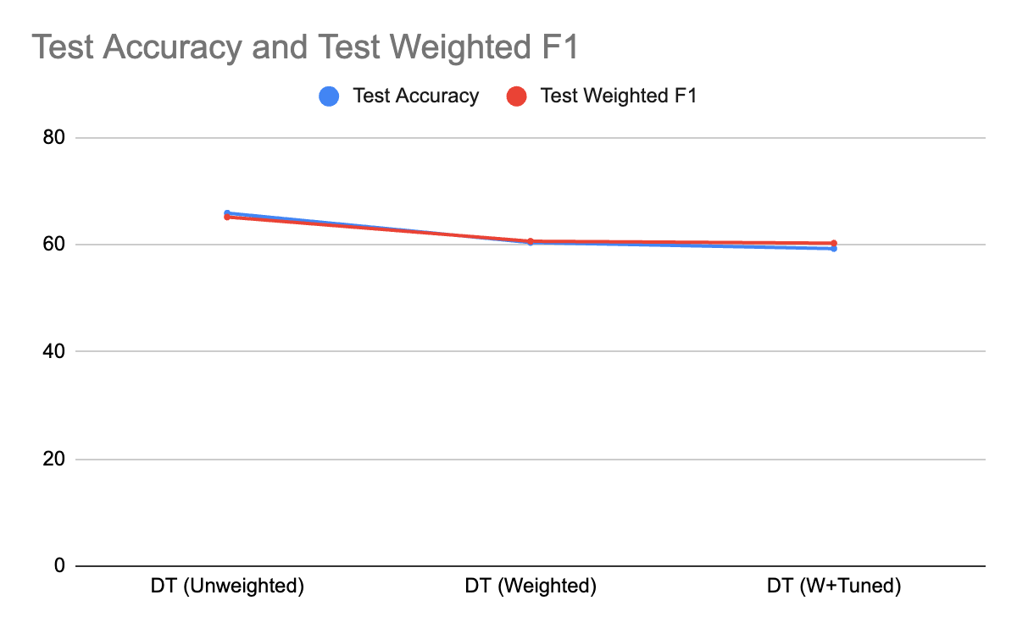
Decision Tree
Three variants:
Unweighted
Weighted
Tuned
Headline metrics fell across three treatments
Examining confusion matrix and one vs rest ROC curves show that class separability improves
Hence all future models adopt weighting and tuning

Slide 9
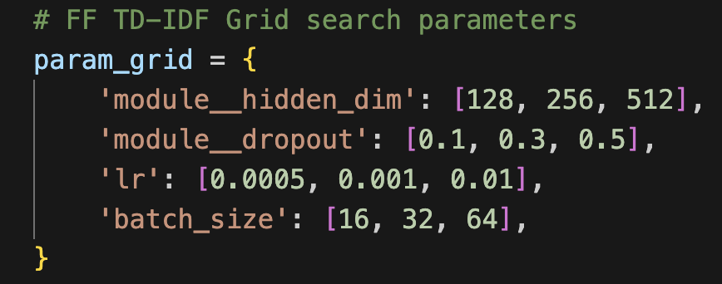
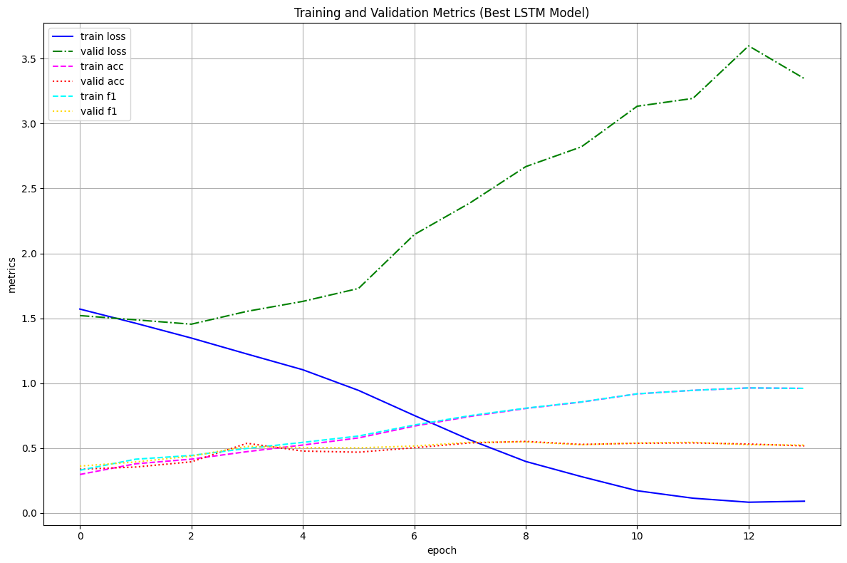
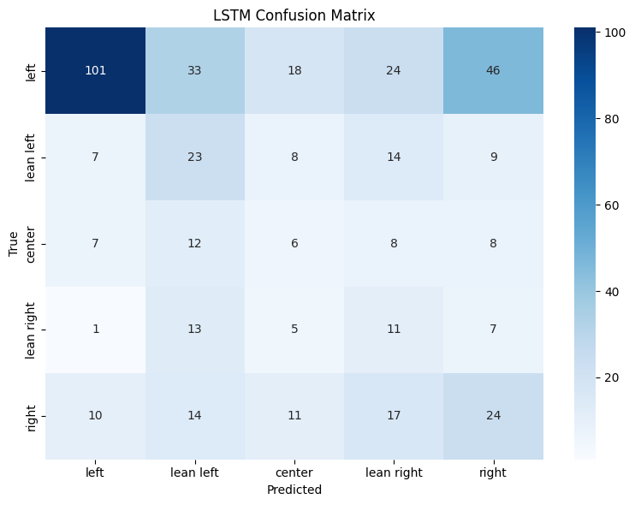
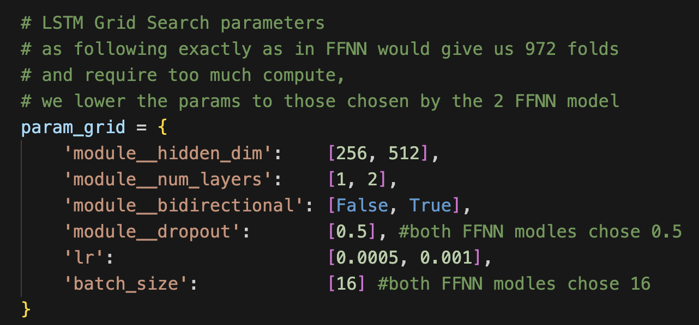
LSTM
Smaller range in hyperparameters gridsearch due to compute constraints
Early stop at epoch 6
Model shows confusion between opposite ends of the spectrum with samples of true left and true right being distributed across all classes indicating that a more balanced data set could be advantageous

Slide 10
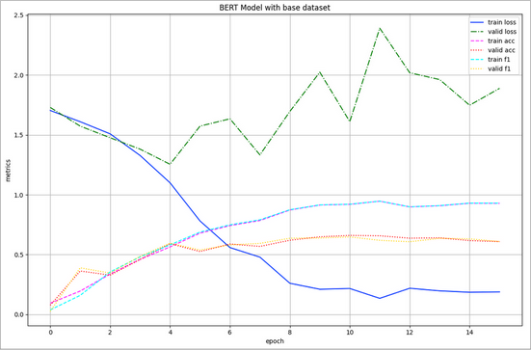
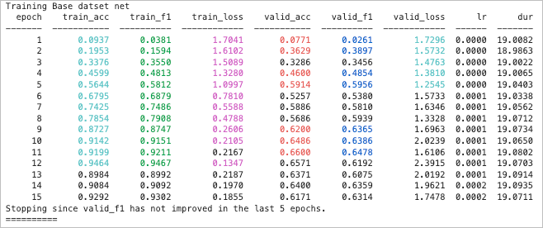
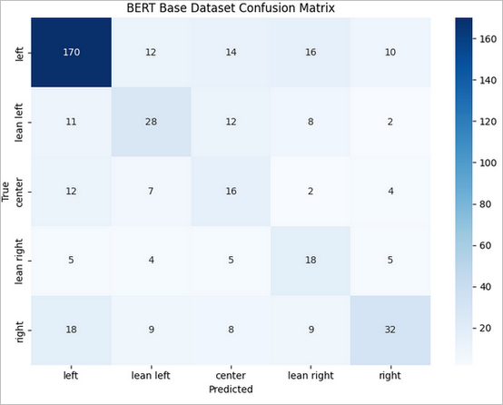
BERT
The base model performed fairly well considering that we only used the pretrained model with an additional linear layer for classification.
The time complexity while high, was still within reason for a consumer grade GPU (RTX 3060) at 19s per epoch. Performance was also good for the time complexity, since we did not do any optimizations on the model.
There were some signs of overfitting when comparing the training and validation loss.

Slide 11
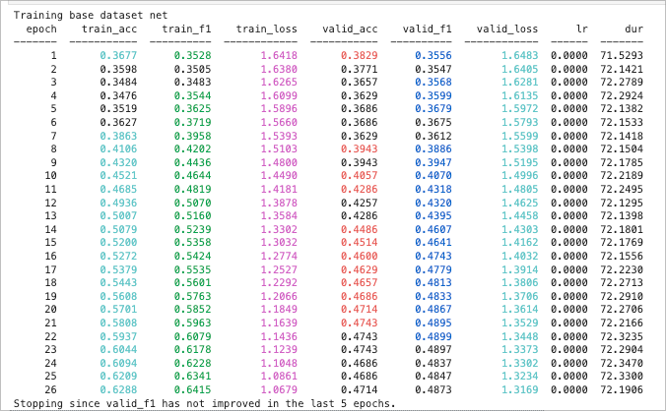
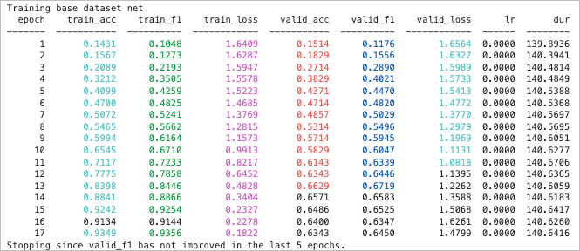
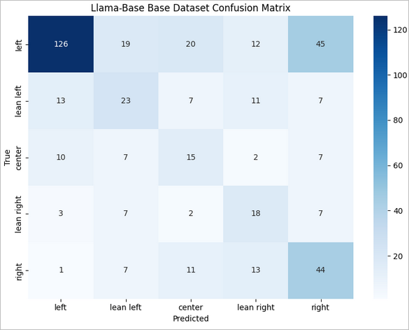
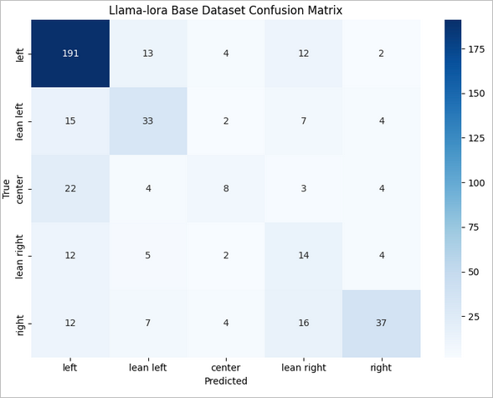
Llama (Base & LoRA)
Base
Base TinyLlama model poor performance relative to the LoRA optimized version of TinyLlama, suggesting that the model needed more fine tuning before having task-specific strong performance.
The LoRA implementation did convert faster (13 vs 22 epochs) during training, which seems to outweigh the additional complexity added from the optimization.
Both the Base & LoRA optimized version showed signs of overfit, but did generalize well relative to the other models.
LoRA

Slide 12
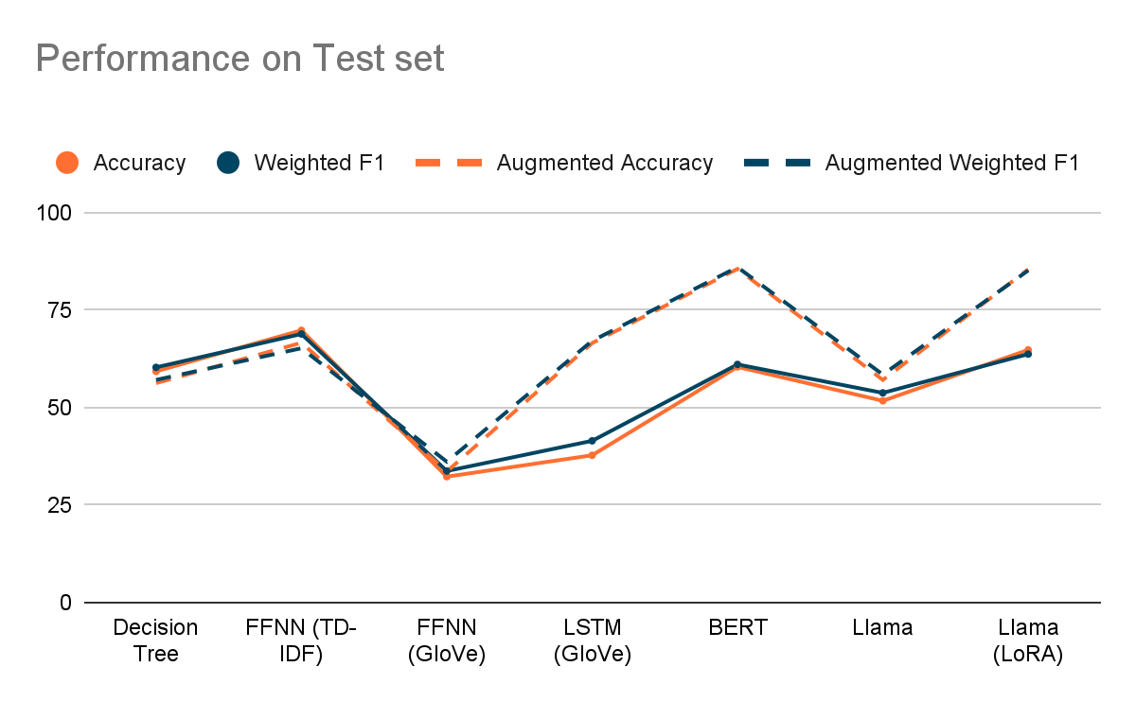
Model 2 - Retraining Headline Metrics Performance
Utilising the same model parameters found in the original runs, the models were re-run with the augmented datasets
Slight falls for decision tree and FFNN (TD-IDF) were not expected, which indicated signs of overfitting previously
Dismal performance for FFNN (GloVe) not improving was also expected.
While we expected performance to increase across the board, of note are the dramatic increases in performance for LSTM and BERT
While BERT & Llama (LoRA) increased significantly, it was surprising that Llama did not. This could have been due to Llama not being able to perform well with only an additional layer for classification.

Slide 13
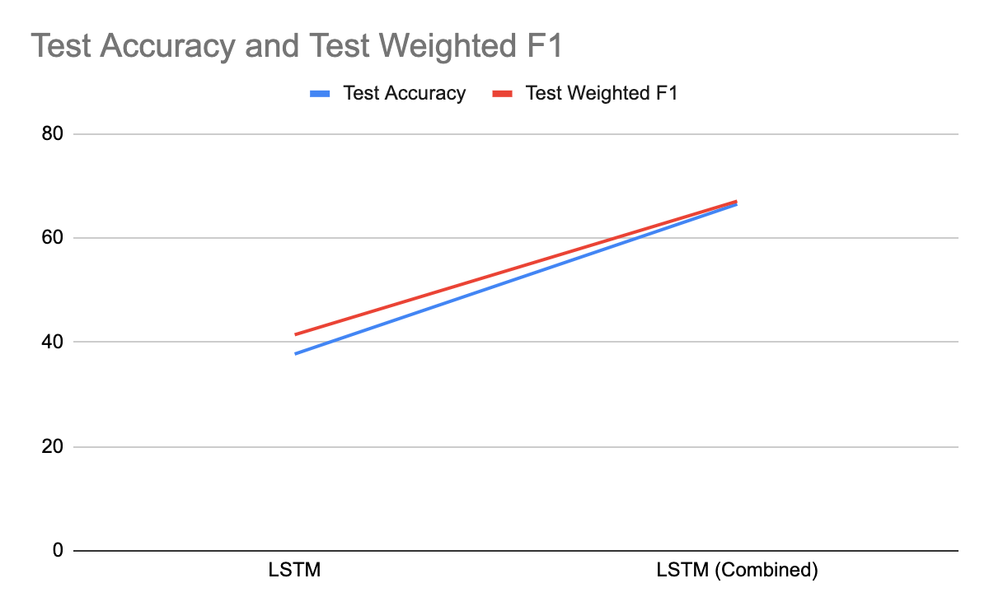
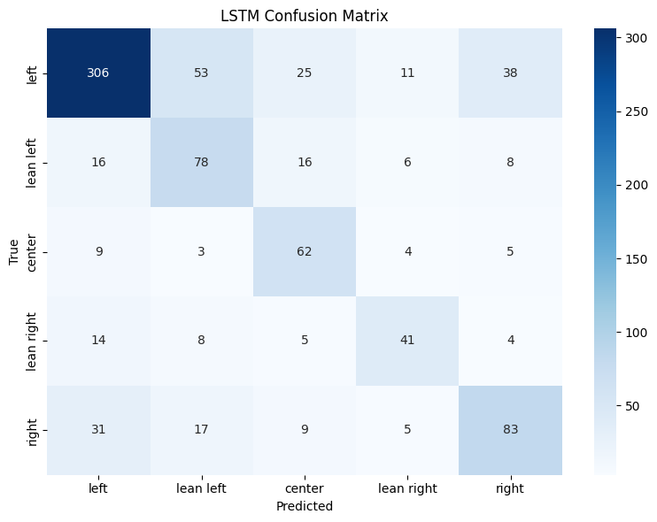
LSTM
Increase in sample size by 16% resulted in jump in performance metrics
Accuracy: 37.76 to 66.51
Weighted F1: 41.46 to 67.08
Modest increase in data resolved ideological confusion and diagonal performance increased
Suggests that balanced data and sequential information are highly relevant for this classification task
With the expanded dataset, LSTM could leverage the additional contextual information, while the FFNN (GloVe) did not capture these patterns from averaged embeddings.
Before
After

Slide 14
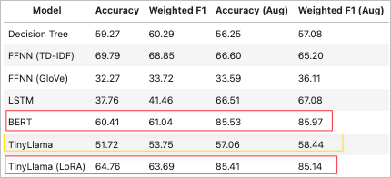
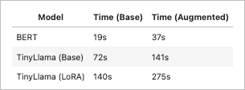
Bert & Llama
Performance for BERT & TinyLlama (LoRA) improved significantly after using the augmented dataset.
TinyLlama (Base) only increased slightly, suggesting that fine tuning is required to adapt the model to classification (or other specific) tasks
Duration increased for all 3 models, around 1.5 times with the augmented dataset. Despite that, BERT was still running much quicker than TinyLlama, and yielded equivalent or better results.
Time per epoch

Slide 15
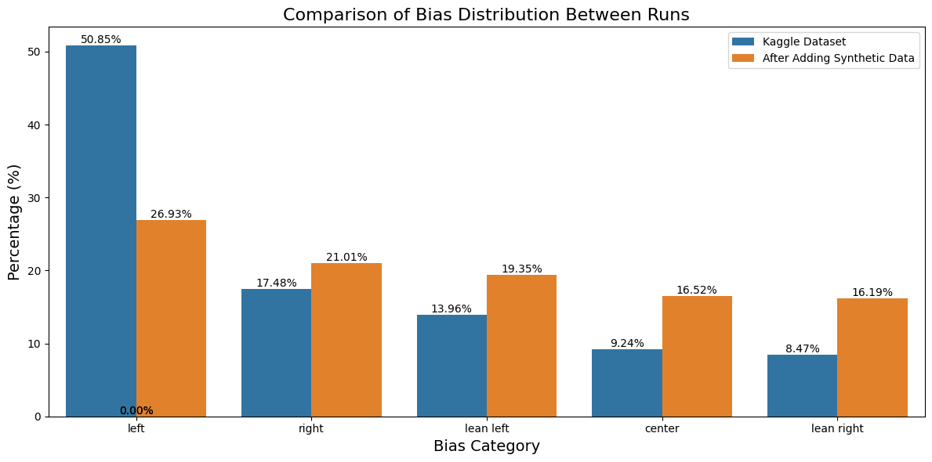
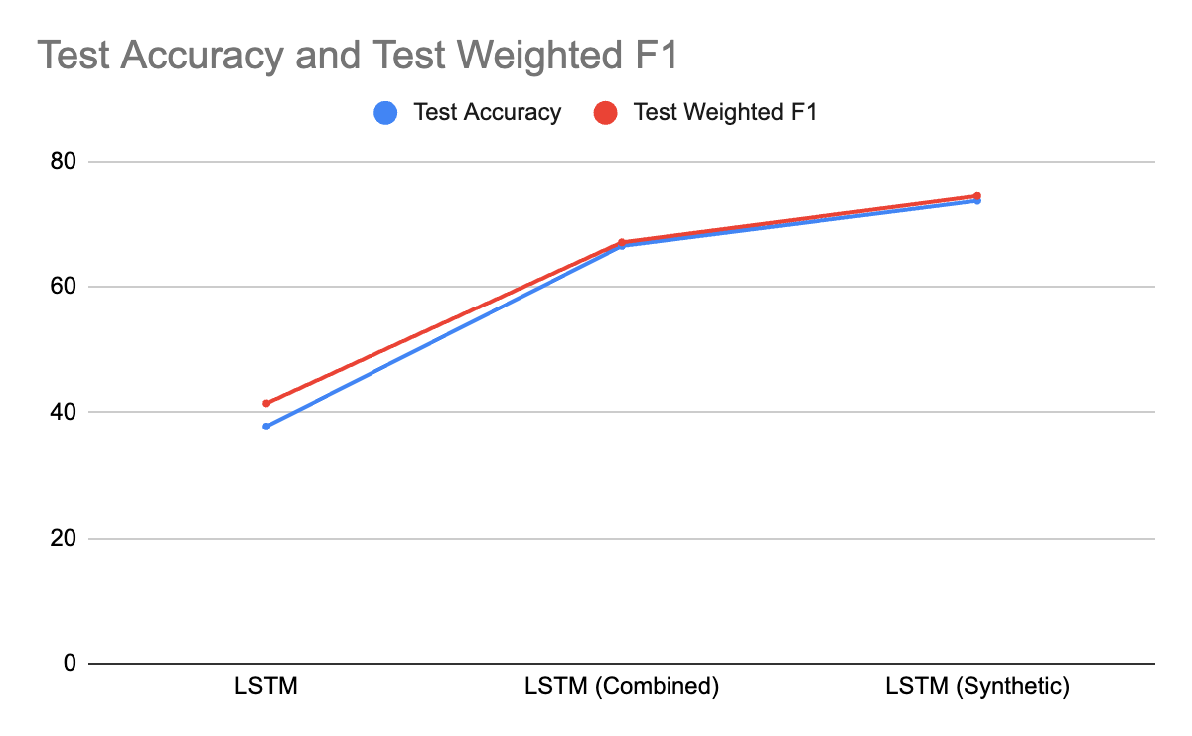
Utilising Synthetic Data
Baseline LSTM: Poor performance
LSTM with Combined Data: Significant performance boost showing that augmenting the dataset with real additional data substantially helps.
LSTM with Synthetic Data: Further marginal gains, suggesting diminishing returns but confirming the value of data augmentation, even when synthetic.
Notes:
Addition of modest real world data to the training data significantly improved LSTM’s performance
Hence we generated synthetic data to boost the
While holding the test set constant, From our implementation in
Utilising the same model parameters found in the original runs, we reran the models with the augmented datasets
While we expected performance to increase across the board

Slide 16
Conclusion
Goal: Enable instant, on-demand bias assessment to enhance media literary
Recommendation: BERT
Has the best overall performance with peak accuracy of 85.53 and peak weighted f1 of 85.97
Only requires 128 tokens for inferencing, which aligns to what is available in article previews and before paywalls
Supports fast inferencing to match a user's scrolling speed when deployed on local devices
Lower compute needed compared to Llama or Llama (LoRA) for implementation in production such as on a user's handphone or laptop
Notes:
This project explored how the gamut of classic to modern machine learning techniques would perform in addressing the goal of classifying a news article into one of five political bias labels.

Slide 17
References
AllSides. (n.d.). Media bias rating methods. AllSides. Retrieved May 2, 2025, from https://www.allsides.com/media-bias/media-bias-rating-methods
World News API. (n.d.). The only News API you’ll ever need. https://worldnewsapi.com/
Media Bias/Fact Check. (n.d.). Search and learn the bias of news media. https://mediabiasfactcheck.com/ ￼
Khandelwal, U., He, H., Qi, P., & Jurafsky, D. (2018). Sharp nearby, fuzzy far away: How neural language models use context. In Proceedings of the 56th Annual Meeting of the Association for Computational Linguistics (Volume 1: Long Papers) (pp. 284–294). Association for Computational Linguistics. https://doi.org/10.18653/v1/P18-1027
Kawin Ethayarajh. 2019. How Contextual are Contextualized Word Representations? Comparing the Geometry of BERT, ELMo, and GPT-2 Embeddings. In Proceedings of the 2019 Conference on Empirical Methods in Natural Language Processing and the 9th International Joint Conference on Natural Language Processing (EMNLP-IJCNLP), pages 55–65, Hong Kong, China. Association for Computational Linguistics.
Liu, Y., Ott, M., Goyal, N., Du, J., Joshi, M., Chen, D., Levy, O., Lewis, M., Zettlemoyer, L. and Stoyanov, V., 2019. Roberta: A robustly optimized bert pretraining approach. arXiv preprint arXiv:1907.11692.

